Slide 1


xyz Ltd.- Acquire to Retire (ATR) – Asset Accounting
16-Feb-2023

Slide 2
Agenda
1.0 Introduction Assessment Objective
2.0 Capability Deep Dive
3.0 Key Design Decisions
4.0 Integrations
5.0 Review Actions – (Question Responses)

Slide 3
Introductions

Slide 4
Session Objective
Fixed Assets
Duration | 2 hours
Objective | Provide an overview of functionalities, leading practice recommendations, and considerations related to Fixed assets management. Gather inputs to design solution for fixed assets books, categories, integration and conversion scope for the implementation of related capabilities
Key Activities | Process Overview Process deep-dive Discuss confirmation questions Review key capabilities and leading practices Discuss data elements and key design decisions
What this is not | Design future state processes, finalize design decisions Gather Requirements Perform Fit-Gap analysis and solutions for business requirements

Slide 5
Fixed Asset : Acquire To Retire
Track wise Process flows for xyz
Reporting
Level 1
Security and Controls (S&C)
Organizational Change Management (OCM)
Procure to Pay (PTP)
Acquire to Retire (ATR)
Record to Report (RTR)
Level 2
Manage Procurement
Manage Payables
Manage Fixed Assets
Manage Accounting and Control Data
Cash Management
Intercompany
Manage Contracts
Vendor setup
Perform Asset Additions
Maintain Enterprise Structure
Bank Statement Reconciliation
Generate Financial IC Transactions
Create Requisitions
Process Invoices
Adjust Assets
Maintain Chart of Accounts
Reconcile IC Accounts
Manage Purchase Orders
Employee Expense Reports
Transfer Assets
Maintain Currency & Rates
Process Receipts
Manage Payments
Retire Assets
Process Interfaced Journal Entries
Level 3
Period End Close
Process Manual Journal Entries
Vendor Onboarding
Reinstate Assets
Approve and Post JEs
Sourcing
Bank and Bank branch Setup
Depreciate Assets Period End Close
Process Reversing JEs
Maintenance Repair Operations (MRO)
Maintain Asset Books
Process Recurring JEs
Short Term Maintenance
Perform Allocations
Perform Closing
(Period End)
Legend :
In Scope- L3 ATR Processes
L3 Processes- Other Tracks
Out of Scope
Financial Reporting

Slide 6
Overview of Asset Life Cycle
Oracle Fusion Assets is a complete Asset Management Solution that maintains Property and Equipment accurately to help you select the best accounting and Tax Strategies
Adjust/Transfer
Depreciate
Retire/Reinstate
Account
Report
Acquire
Acquire
Acquired and converted assets to be recorded in Oracle
Sources of adding assets – Payables, Projects, Manual, Spreadsheet, other External Sources if any
Adjust/ Transfer
Making financial/non financial adjustments to the asset cost, category, etc.
Transferring an asset from 1 location to another
Depreciate
Depreciate the asset through various methods such as SLM, MACRS, etc. as applicable
Retire/Reinstate
Sell/Dispose the asset after the useful life
Account
Account for the various transactions happening on an asset in the asset books and general ledger
Report
Provides reports for asset additions, transfers, retirements and other changes ensuring the asset inventory remains accurate.

Slide 7
Acquire To Retire (ATR)
ASSET ADDITIONS

Slide 8
Asset Additions
Asset additions is the process of recording an asset that has been acquired in Oracle Cloud. Assets can be added using the following methods:
Source | Description
Manual | Add asset directly in Fixed Asset module using user interface.
Spreadsheet (ADFDI) | Add asset directly in Fixed Asset module using spreadsheet upload. When asset volume is high, enter information in macro enabled Excel template and upload the data
Account Payable (AP) and Projects (Mass Additions) | Create asset through AP invoices using the asset clearing account distribution in AP invoice expense line
Discovery Questions
What are the source systems of asset additions?
What type of assets are being maintained: Leased, CIP etc.?
Integrations with 3rd party systems
Current Volume of active assets
Leading Practices
Minimize data entry by integrating with upstream processes like Payables, Integrate it with fixed assets
Minimize prior period addition by processing all current period assets before closing FA books
Leading practice is to start the asset numbering in the new system from a number greater than the number of legacy assets. For example, if the legacy system has 9712 assets to be converted, the new sequence in Oracle can start 10000 giving a few buffer values as well.

Slide 9






Assets Additions - Cont.
Manual Additions
Quick Additions
Oracle Payables
Oracle Projects
Legacy Systems
Web ADI
Base Tables (FA_MASS_ADDITIONS)
Asset Books
Asset Books
Asset Retired
Scrap Sales
Depreciation

Slide 10
Asset Types
Types of assets that can be created in Oracle are as under:
Capitalized
Construction in Progress
Expensed
Group
To capitalize an asset is to put it on your balance sheet instead of “expensing" it. The idea is to spread the expense out over time instead of recording the full cost against the current income statement.
A construction-in-process (CIP) asset is an asset you construct over a period of time. Create and maintain your CIP assets as you spend money for raw materials and labor to construct them.
When you finish building the CIP asset, you can place it in service and begin depreciating it.
Low-value assets and assets that do not depreciate but are nevertheless tracked as assets are classified as expensed assets. They are only used for tracking purposes
The entire cost for these assets are expensed when the asset is acquired.
A group asset is a collection of member assets. Member assets are the individual assets that belong to a group asset.
Capitalization Threshold
Capitalization threshold specifies the minimum cost of an asset to be eligible for automatic capitalization
Low Value Threshold
The Low Value threshold specifies the maximum cost of an asset that is considered to be a low-value asset.
It must be fully depreciated in the period of acquisition or in the first year of life
Discovery Questions
Asset Capitalization and low value asset threshold and treatment for expensed assets
For example, if the Capitalization threshold is $3,000 and the Low Value threshold is $5,000:
Asset cost is less than $3,000: Asset is Expensed
Asset cost is between $3,000 and $4,999.99: Low value asset will be fully depreciated in the period of addition
Asset cost is $5,000 or more: Asset is Capitalized

Slide 11
Pre-requisites for Asset Additions
While adding an asset in Oracle Cloud Fixed Assets, certain values should be configured to ensure accurate asset addition for tracking and reporting purposes. These values are configured using Flexfield values which are detailed as under:
Flexfield | Description
Asset Category | Asset category Flexfield values are used to define categories and group assets by financial information in relevant categories. For example: Major Segment value: Computer Equipment Minor Segment Value: Laptop Asset category are linked with Depreciation Rules, Tax Book Depreciation Rules, Prorate Convention, GL Accounts (Asset Cost Account, Asset Clearing Account, Depreciation account etc.)
Asset Location | Asset location Flexfield values are used to define location values to group and track assets by physical location. For example: Country: US State: California City: San Francisco Site: Downtown
Asset Key | Asset key Flexfield values are used to group assets by non-financial information. This key Flexfield supports only one structure. Need to decide how many levels (segments) your asset key structure needs.
Discovery Questions
What are the asset categories as per current ERP system?
How is physical information tracked at present?
Key Design Decision
No. of segments to be defined for Category and Location Flexfields
Leading Practices
Two segments in Asset Category - Major Category, Minor Category
Align Major Asset Categories to Balance sheet asset heads – PPE, Land, Land Improvements, Building, Building Improvements, Intangible Assets (like Goodwill)
Define location values based on both current and future needs.
Use standard location names or abbreviations that are easily identified and understood.

Slide 12
Acquire To Retire (ATR)
ASSETS ADJUSTMENTS & TRANSFERS

Slide 13
Asset Adjustments
An asset undergoes various types of adjustments as per business needs during its life cycle, which are covered under Oracle Cloud Fixed Assets and listed as under:
Financial Adjustments
Cost (Including Revaluation and Impairments as may be required to meet local GAAP requirements)
Non- Financial Adjustments
Depreciation Method
Date Placed in Service
Asset Categories
Discovery Questions
What are the types of adjustments generally performed on assets?

Slide 14
Asset Revaluation
Asset Revaluation is the process of adjusting carrying value of the asset, to reflect its fair value. After revaluation depreciation is calculated on revalued cost of the asset. It can either result into increase or decrease in carrying value of the asset.
Basis of revaluation are stated below:
Revaluation of an asset is a local requirement for the following countries:
Austria
Finland
Germany
Israel
Poland
UK
Australia
By Net Book Value
By Cost
Example:
Before Revaluation : Asset Cost - $ 1000; Accumulated Depreciation - $100; Net Book Value - $ 900.
Cost of the asset is revalued by 10%
After Revaluation : Asset Cost - $ 1100; Accumulated Depreciation - $ 110; Net Book Value - $ 990; Revaluation Reserve - $ 90

Slide 15
Asset Impairments
An asset is impaired when the book value of the asset exceeds its recoverable value. An asset must be evaluated for impairment periodically in accordance with the local accounting requirements of the countries
If there is any indication of impairment, then the impairment loss is to be recognized by:
Estimating the recoverable value of the asset.
If the recoverable value of the asset is less than its book value, reduce the carrying amount of the asset to its recoverable value.
Example:
Cost of the Asset: $90,000
Depreciation per annum: $5,000
Net Book Value of the Asset after 2 years: $80,000
Value in Use (Recoverable Value) : $70,000
Impairment loss to be accounted for: $10,000
Revised Asset Value: $70,000
Impairment of an asset is a local requirement for the following countries:
Austria
Romania
Switzerland
Finland
Germany
Israel
Poland
UK
Australia

Slide 16
Asset Transfers
An asset may be required to be transferred within the organization as per business needs which is covered under Oracle Cloud Fixed Assets as under:
Transfer within different departments of a legal entity
Discovery Questions
What type of transfers happen in general course of business? Between - Employees, Locations, Depreciation Expense Accounts
Transfer to a different location in the same legal entity
Transfer amongst two legal entities in the same country
Cross border transfers from one LE to another LE
Transfer from one Employee to another Employee
Transfer from one Expense Account to another

Slide 17
Acquire To Retire (ATR)
ASSETS RETIREMENT & REINSTATEMENT

Slide 18
Asset Retirement
An asset can be retired after the end of its life cycle.
Retire an asset when it's no longer in service, for example, if it was stolen, lost, damaged, sold, or returned. When retiring an asset, you can retire an asset completely or you can retire part of an asset. Oracle Cloud provides the following basis for retiring assets:
Retirement
Type
Discovery Questions
Full Retirement
Partial Retirement
Is gain/loss recognized on all types of asset disposals?
What kind of audit trail is expected for asset retirements/disposals?
Retirement
Basis
Units
Cost
Units
Cost
An asset can be either retired fully or partially.
Example:
Asset Cost: $10,000
Net Book Value (NBV): $8,000
No. of Units: 2
This asset can be retired in the following combinations:
Full Retirement – Retiring the complete cost of $10,000 or both the units
Partial Retirement – Retiring a portion of the asset cost or retiring 1 unit. The NBV is adjusted accordingly to spread across the remaining asset

Slide 19
Asset Reinstatement
Reinstatements are reversals of retirements, which correct the retirement errors by undoing the retirement of an asset and restating it.
Oracle Cloud Assets provides the functionality for users to reverse retirement transactions.
There can be instances when an asset is wrongly retired due to lack of information.
When a retired asset is reinstated, Oracle Assets calculates the additional depreciation expense that was missed during the period for which the asset was retired.
The depreciation amount at the time of reinstatement is controlled by the below factors:
Retirement convention:
Date of retirement:
Period in which asset is reinstated:
Reinstatement can be done only for assets retired in the current fiscal year.
Discovery Questions
Frequency of asset reinstatement

Slide 20
Acquire To Retire (ATR)
DEPRECIATE ASSETS & PERIOD CLOSE

Slide 21
Depreciation
The asset’s value reduces with time due to wear and tear. This decline in an asset’s economic and physical value is called depreciation. Oracle Cloud Fixed Assets provides various depreciation methods as well as the capability to configure depreciation methods in line with company’s financial and accounting needs. Some of the pre-defined depreciation methods are listed below:
Calculated
Calculates the depreciation based on the life of an asset by spreading the asset cost evenly over the useful life of the asset.
Table Based
Calculates depreciation at different rates across the life span of the assets.
Flat Rate
Calculates depreciation at predefined rates, such rates can be applied to recoverable cost or Net Book Value
For example: Straight Line Method (SLM)
For example: Modified Accelerated Cost Recovery System (MACRS)
For example: Declining Balance i.e.: Written down Value (WDV) Method
Discovery Questions
What are depreciation methods in use?
Any custom depreciation method?
Do you have any process to handle the amortization of intangible assets?
Localization requirements for countries in SOW with respect to depreciation
Key Design Decision
1. Depreciation Methods

Slide 22
Depreciation Determinants
Determinants of Depreciation
Prorate Convention
Prorate convention determines the start date of depreciation of assets. This can be “Date Placed in Service”, “Following Month”, “Current Month”, “Half-Year”, etc.
Retirement Convention
To determine how much depreciation to take in the last year of life based on the retirement date.
Depreciation & Prorate Calendar
Depreciation Method
Depreciation Ceilings
The depreciation program uses the depreciation calendar and divide depreciation flag to determine what fraction of the annual depreciation expense to take in each period. Prorate calendar to determine the prorate period which is used to choose the depreciation rate.
Depreciation methods specify how to allocate the asset cost. There are different depreciation methods available in Oracle. Such as Life based Methods, Flat-Rate Method, Straight-Line Method, Formula Based Method and Table-based Methods.
It specifies the limit for depreciation expense to an asset for the year.

Slide 23
Accounting for Assets
Accounting Process for assets in Oracle cloud is as below:
Transactions in Fixed Assets module
Run Accounting Process in Fixed Assets subledger
Transfer to General Ledger
Oracle Fixed assets creates journal entries that summarize the activity for each account for each transaction type
Create Accounting is the program which is supposed to be run to generate the accounting journal entries
Create Accounting program can be run in either Draft Mode or Final Mode
Periods for which the entries are to be posted from Assets to General Ledger should be aligned

Slide 24
Fixed Assets Period Close
Current open fixed assets period should be closed in order to open the next period. At a time only 1 period can be opened under Oracle Cloud Fixed Assets and once a period has been closed, it cannot be re-opened. Procedural aspects of period close are stated below:
Close Accounts Payable module prior to closing Assets module to ensure all goods are recorded as assets
Use clearly defined asset categories and assign standard depreciation methods wherever possible to reduce possible errors
As the periods for fixed asset cannot be re-opened once they have been closed, make sure to complete the following processes before period close:
Prepare and Post Mass Additions
Complete all Manual Additions
Complete Adjustments
Complete Retirements
Complete Transfers
Complete Reinstatements
Run Depreciation and don’t post the entries before reviewing the depreciation figures to the ledger. Once everything is reviewed and finalized, then post the depreciation to the ledger.
Run the General Ledger and Sub ledger Account Analysis reports to reconcile asset balances in the Assets module and General Ledger module
Discovery Questions
Current Close Standard Operating Procedure

Slide 25
Acquire To Retire (ATR)
MAINTAIN ASSETS BOOK

Slide 26
Asset Books
Transactions performed on an asset are recorded in the relevant asset books, structure for maintaining asset books in Oracle Cloud is explained below:
Multiple asset books can be configured, each book has its own set of depreciation rules, accounts and calendars to organize and implement fixed assets accounting polices effectively.
Corporate Asset Books are used to hold all the asset information, depreciation and accounting entries to post to the General Ledger as per GAAP.
Tax and Local Asset Books are used to retain information as per local laws and accounting rules for depreciation, fiscal years and accounts for asset data which is copied from corporate book.
Mass Additions
Other Subledgers
Payables
Projects
Manual
Asset Flexfields
Asset Location
Asset Key
Asset Location
Asset Additions
Subledger Accounting
Tax
Asset Book
Corporate
Asset Book
Mass Copy Assets to Tax Book
Local Stat Asset Book
Key Design Decision
Fixed Assets
1. Number of Tax and/or Local Books per LE?
Accounting other than Fixed Assets
Leading Practices
General Ledger
One Corporate asset book for each country mapped to primary ledger.
Create a tax/local asset book for different reporting requirements for legal entities.
Accounting entries not posted to General Ledger from Tax Asset book.
Primary Ledger
Secondary Ledger
(Set to inherit non Fixed Assets accounting from Primary)

Slide 27
Asset Book Design – Scenario 1
Asset Book Design – Scenario 2
Business Need : A company with Business in United States needs to prepare financial statements for Management reporting purposes. The Tax department has special depreciation requirements for taxation (IRS) purposes
Recommended Solution: Create a corporate book and 1 associated tax books. We can have multiple tax books based on the requirements. All the tax books are associated with One Corporate book.
Business Need : A company with Business in United States required to prepare financial statements for Management reporting purposes under both IFRS & US GAAP Accounting convention or representation.
Recommended Solution: Create a corporate book for the Primary Ledger with US GAAP convention and as associated Tax Book for the Secondary Ledger with IFRS rules.
Primary Ledger
Primary Ledger
US GAAP
Chart of Account
Calendar
USD
Corporate Book
Book: CORP BOOK
Ledger: Primary Ledger
Post to Ledger: Yes
US GAAP
Chart of Account
Calendar
USD
Corporate Book
Book: CORP BOOK
Ledger: Primary Ledger
Post to Ledger: Yes
Secondary Ledger
US IFRS
Chart of Account
Calendar
USD
IFRS Tax Book
Associated Corp Book: CORP BOOK
Ledger: Secondary Ledger
Post to Ledger: Yes
Federal Tax Book
Associated Corp Book: CORP BOOK
Ledger: US Ledger
Post to Ledger: No

Slide 28
Conversion – Data Elements
Following table represents scope for master/transactional data conversions
No | Action Item | Extraction Criteria (Recommended) | Comment
1 | Corporate/Tax Asset Book Data | File Based Date Import Template
2
3
4
5
6
7

Slide 29
Acquire To Retire (ATR)
ORACLE CLOUD FIXED ASSETS REPORTING

Slide 30
Oracle Cloud Standard Reports
Below is a list of Standard Reports provided by Oracle Cloud:
Report Name | Report Description
Asset Additions by Responsibility Report​ | Lists assets added or capitalized during the specified periods. Displays the owner and location for each unit. Sorts and totals by balancing segment, asset type, asset account, cost center, and reserve account.​
Asset Balances Register​ | Lists the cost-related details, current activity, and retirements for every asset within the selected asset category. Lists all transactions that impact asset cost during the chosen period.​
Asset Category Change Report​ | Lists all the assets for which the asset category is changed during the specified period. The report is sorted by and groups totals for each balancing segment, asset account, and asset number.​
Asset Impairment Report​ | Lists the impact of impairment transactions. Displays cost, new net book value, net selling price, value in use, and impairment loss amount for all the impaired assets in the given book and depreciation period. The report is sorted by the asset number. The report shows totals for Current Net Book Value, Net Selling Price, Values in Use, Impairment Loss, and New Net Book Value.​
Asset Leases Expense Report​ | Lists asset lease interest and expense amounts for the specified period. The report is sorted by and groups totals for each balancing segment, expense account, and cost center.​
Asset Register Report​ | Lists initial costs, current reserve, year-to-date amounts, depreciation rules, and retirements for a range of assets for the specified corporate book ​ and for each associated tax book. The report sorts the data by asset number.​
Assets by Cash Generating Unit Report ​ | Data model is used for the US Form 4562 - Depreciation and Amortization Report. The data model extracts the depreciation amounts, depreciation reserve adjustments, balancing segment, fiscal year of addition, depreciation method information, asset category, and asset number from Oracle Assets.​
Asset Balances Register​ | Lists the cost-related details, current activity, and retirements for every asset within the selected asset category. Lists all transactions that impact asset cost during the chosen period.​

Slide 31
Oracle Cloud Standard Reports
Report Name | Report Description
Asset Category Change Report​ | Lists all the assets for which the asset category is changed during the specified period. The report is sorted by and groups totals for each balancing segment, asset account, and asset number.​
CIP Summary Report​ | Lists CIP cost account summary balances for the specified periods. The report is sorted by and groups totals for each balancing segment and CIP cost account.​
Cost Adjustments by Source Report​ | Lists all the asset cost adjustments made during the specified periods and shows the details of associated invoice lines. Sorts and totals by source, balancing segment, asset type, asset account, cost center, and asset number.​
Asset Lease Expenses Report​ ​ | Lists asset lease interest and expense amounts for the specified period. The report is sorted by and groups totals for each balancing segment, expense account, and cost center.​ ​
Asset Lease Liability Report​ ​ | Lists asset lease liability for the specified period. The report sorts by and groups totals for each balancing segment, liability account, and cost center.​ ​
Asset Lease Data Extract Report​ ​ | Extracts and displays the current asset lease data in the Lease Addition File-Based Data Import template format​ ​
Repository of Standard Reports

Slide 32
Oracle Transactional Business Intelligence (OTBI)
OTBI provides predefined analytics and reports that help in analyzing data to support business needs. The repository is organized into subject areas. Each subject area contains columns corresponding to a specific business area or object in the cloud application. These columns are thereafter selected to view the data that is to be analyzed and reported on. Subject Areas available for fixed assets as under:
Fixed Assets - Asset Balances Real Time
Summarizes information on various activities such as additions, adjustments, retirements, reclassification, transfer, revaluation, depreciation on a period and helps to reconcile the balance with General Ledger
Fixed Assets - Asset Balances Real Time
Real time information on depreciation value and balance of an asset for each asset book such as the cost center, ledger and sub-ledger, asset depreciation account, asset book, asset category and asset depreciation.
Fixed Assets - Asset Transactions Real Time
Real time information on the transactions associated with asset such as additions, transfers, adjustment, retirement, reinstatement. Includes accounting details, asset book, asset category, type of asset, location and cost center.

Slide 33
Key Integrations
Following table represents scope for integrations with edge applications as per current landscape
No | Integration | Source System | Target System
1
2
3
4
5
6
7

Slide 34
Leading Practices: Manage Fixed Assets
L3 Process | Leading Practices
Maintain Statutory and Tax Books | A tax reporting book is associated with a corporate book so that a single asset and its transactions are easily maintained with different accounting and depreciation details. Maintain one corporate asset book per primary ledger.
Maintain Statutory and Tax Books | Create separate US GAAP asset book if there is a reporting requirement for fixed assets for each legal entity Create a separate Tax book for representing a single asset with different financial treatment viz, Prorate convention / Depreciation Method/ Life etc.
Perform Asset Additions | Minimize data entry by integrating with upstream processes like Payables and Projects
Perform Asset Additions | Minimize prior period addition by processing all current period assets before closing FA books Asset should be reinstated only when the asset retired is actually received back by the business for further active use
Perform Asset Additions | If an asset is reinstated in the subsequent financial year, it must be treated as a new asset addition
Maintain Assets | Use clearly defined asset categories wherever possible to reduce possible errors usually asset category has 2 segments Major & Minor.
Maintain Assets | Generate the asset details based on each location by capturing the physical location of each asset Conduct a physical verification of the asset by capturing the location of each asset If Assets are maintained in a foreign location, represent such assets in the functional currency to ensure consistency in reporting Reclassify assets to update information, correct data entry errors, or when consolidating categories Reconcile the asset cost and depreciation reserve accounts after asset reclassification by running reports in subledger and GL. Create asset transfer from one accounting books to another by disposing off in one book and add the asset by way of additions in receiving entity’s book.

Slide 35
Leading Practices: Manage Fixed Assets
L3 Process | Leading Practices
Maintain Assets | Avoid prior period asset transfers to reflect correct transfer details for a financial year Minimize manual processing by leveraging available mass transactions functionality
Retire and Dispose Assets | Perform Receivable processes for asset sale and perform the retirement on receiving the actual disposals While retiring an asset, ensure that the gain/loss on sale of asset is determined and accounted accordingly
Retire and Dispose Assets | Avoid retiring an asset in the same period as that of its addition. Exercise caution while adding such assets initially
Depreciate and Amortize Assets | Assign standard depreciation methods wherever possible to reduce possible errors For effective fixed asset management, ensure that the calculated depreciation is correct
Depreciate and Amortize Assets | Perform and review periodic depreciation run only after completing the asset sub processes such as additions, adjustments, transfers, retirement and reinstatements. Always run depreciation in draft mode first to confirm there are no issues or errors before running in final mode and closing the period
Depreciate and Amortize Assets | Leverage a single, standard, end-to-end fixed asset accounting process – across all business units and geographies
Perform Assets Period Close | Close the asset periods after reviewing and reconciling the reports with balances in general ledger. This approach enables to rectify the process or entries incorrectly generated.
Perform Assets Period Close | Process transactions from all source systems before closing Fixed Assets. This helps to ensure transactions are completed and transferred to Fixed Assets prior to closure of fixed asset period

Slide 36
Demo Screenshots

Slide 37
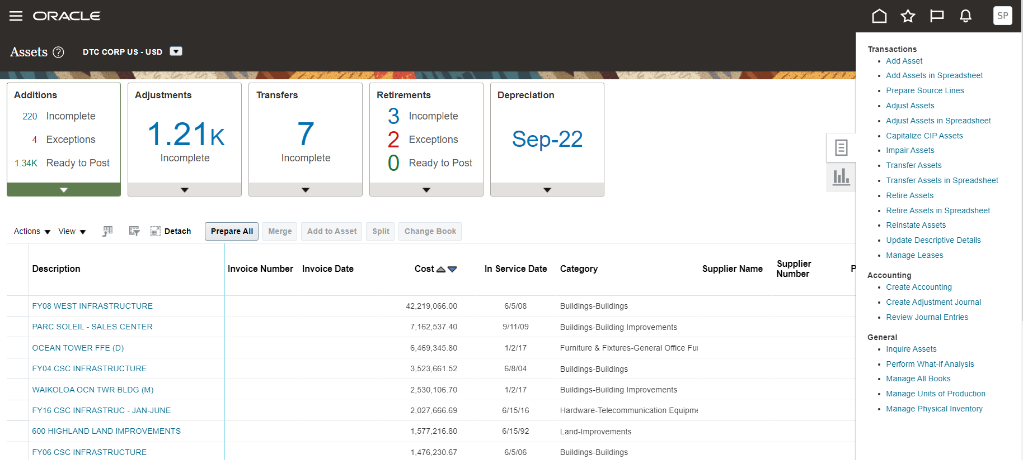
Fixed Assets Dashboard and Task Menu

Slide 38
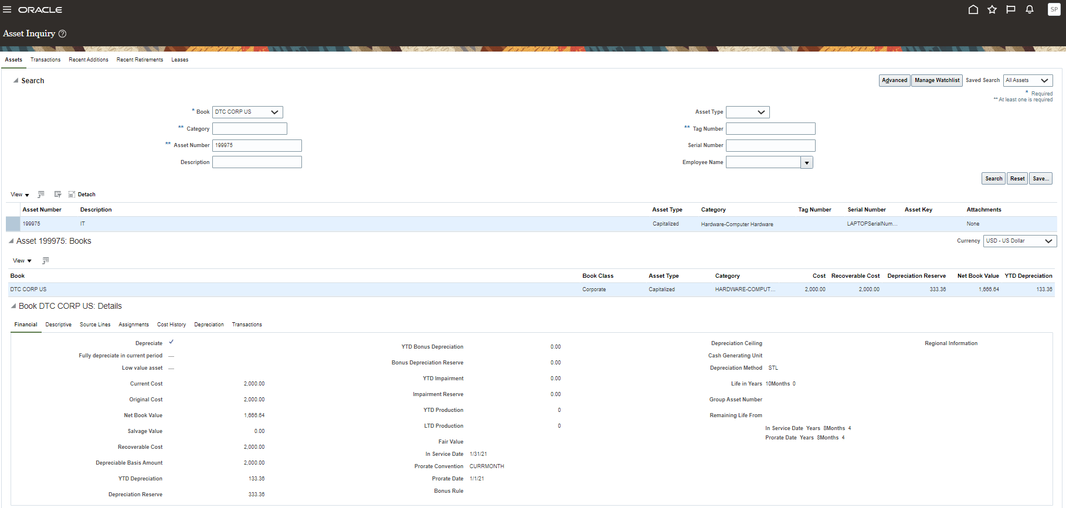
Asset Inquiry

Slide 39
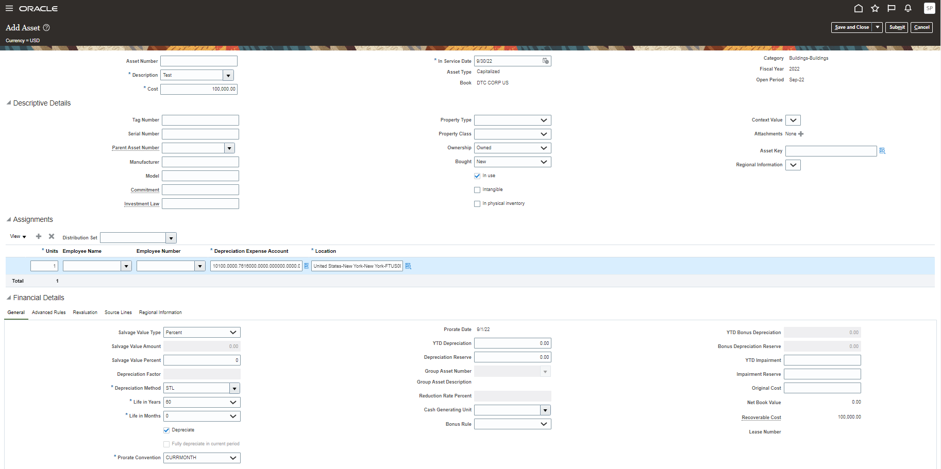
Asset Addition

Slide 40
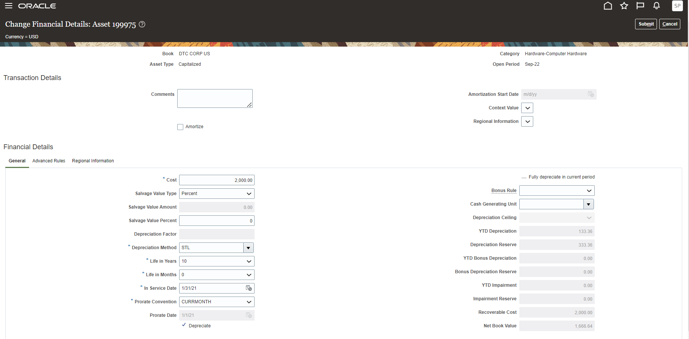
Asset Adjustment

Slide 41
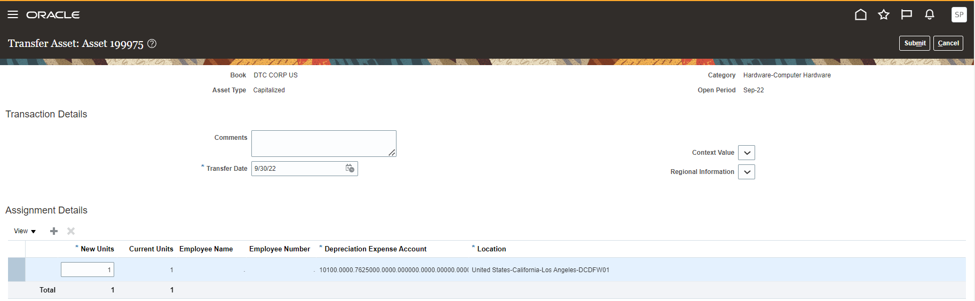
Asset Transfer

Slide 42
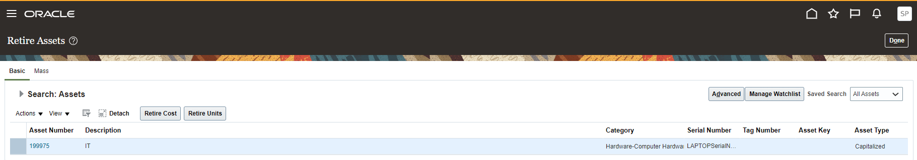
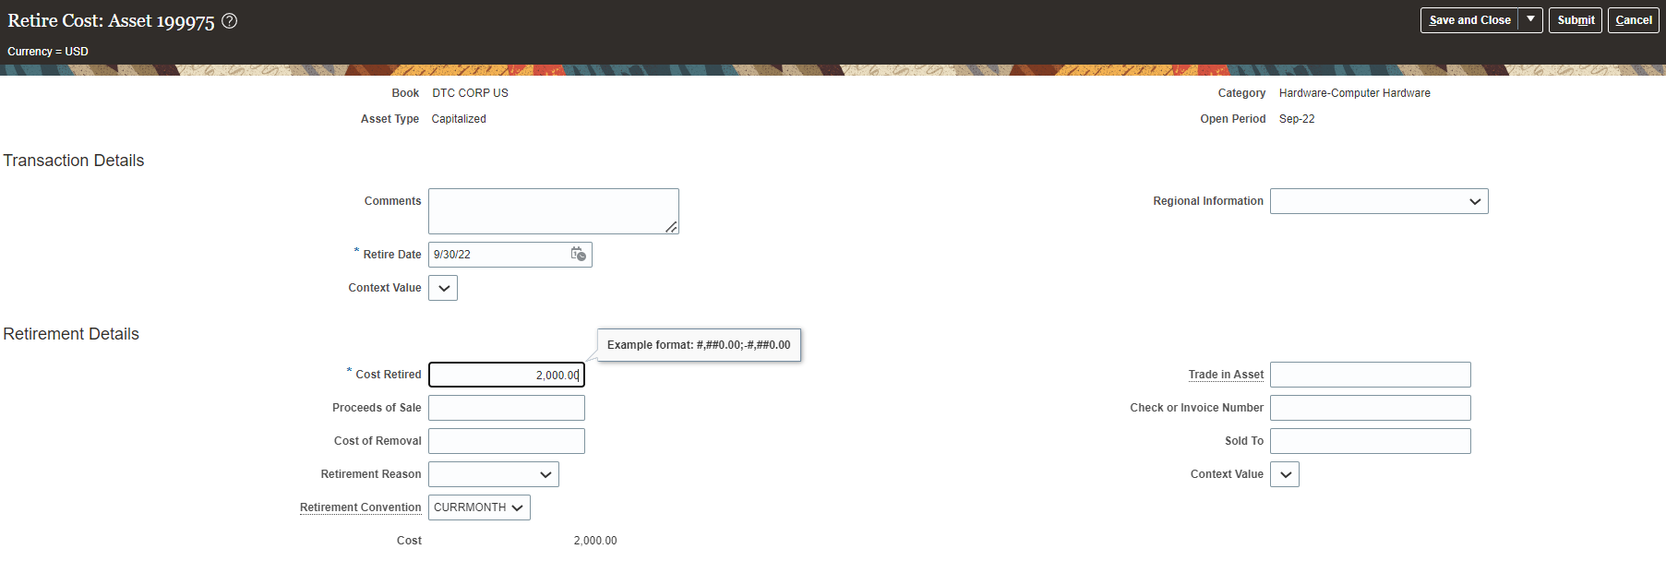
Asset Retirement

Slide 43
Appendix

Slide 44
Review Action Items
No | Action Item | Comment | Owner | Due Date
1 | List of Asset Categories
2 | Do you track the location of assets
3 | How many legal entities track fixed assets
4 | Do you calculate tax depreciation/ maintain tax books for each country?
5 | How many assets do you procure in any given accounting period
6 | What is the current process for CIP assets?
7 | Do you track any assets that are not capitalized and/or depreciated (e.g., expensed assets)

Slide 45
Review Action Items
No | Action Item | Comment | Owner | Due Date
8 | Do you have and track intangible assets
9 | What types of assets transfers do you process (location/entity) How often do you transfer assets?
10 | Do you leverage asset tags or maintain asset serial #'s
11 | What other asset attributes do you track
12 | Do you have leased Assets? Are you the Lessee or the Lessor?
13 | What is the Accounting Classification of the Lease? Operating, Finance, Exempt?
14 | Do you perform physical inventories of your fixed assets?
15 | How do you manage the amortization of asset adjustments (remaining useful life, etc..)
16 | Reconciliation issues between asset books and GL for asset cost and depreciation reserve

